Slide 1
Useful data types

Slide 2
String
A sequence of characters.
It’s actually from java.lang.String. It’s a Java class.
A string is immutable.
Notes:
object MyString { val s1: String = "Hello there. " val s2: String = "General Kenobi" val n1 = 66; val n2 = 98.45 def main(args: Array[String]): Unit = { println(s1.length()) println(s1 + s2) println(s1.concat(s2)) printf("%s: Order (%d) ,has been %f percent completed.", s1, n1,n2) val result = printf("%s: Order (%d) ,has been %f percent completed.", s1, n1,n2) println(result) println("%s: Order (%d) ,has been %f percent completed.".format(s1, n1,n2)) } }

Slide 3
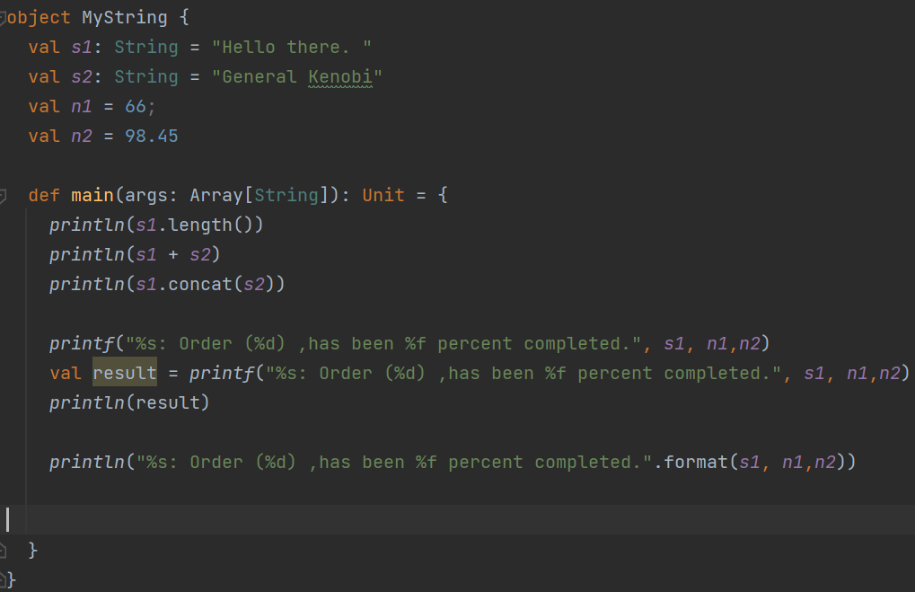
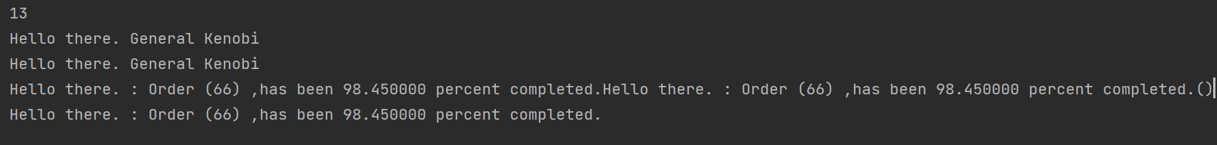
Notes:
object MyString { val s1: String = "Hello there. " val s2: String = "General Kenobi" val n1 = 66; val n2 = 98.45 def main(args: Array[String]): Unit = { println(s1.length()) println(s1 + s2) println(s1.concat(s2)) printf("%s: Order (%d) ,has been %f percent completed.", s1, n1,n2) val result = printf("%s: Order (%d) ,has been %f percent completed.", s1, n1,n2) println(result) println("%s: Order (%d) ,has been %f percent completed.".format(s1, n1,n2)) } }

Slide 4
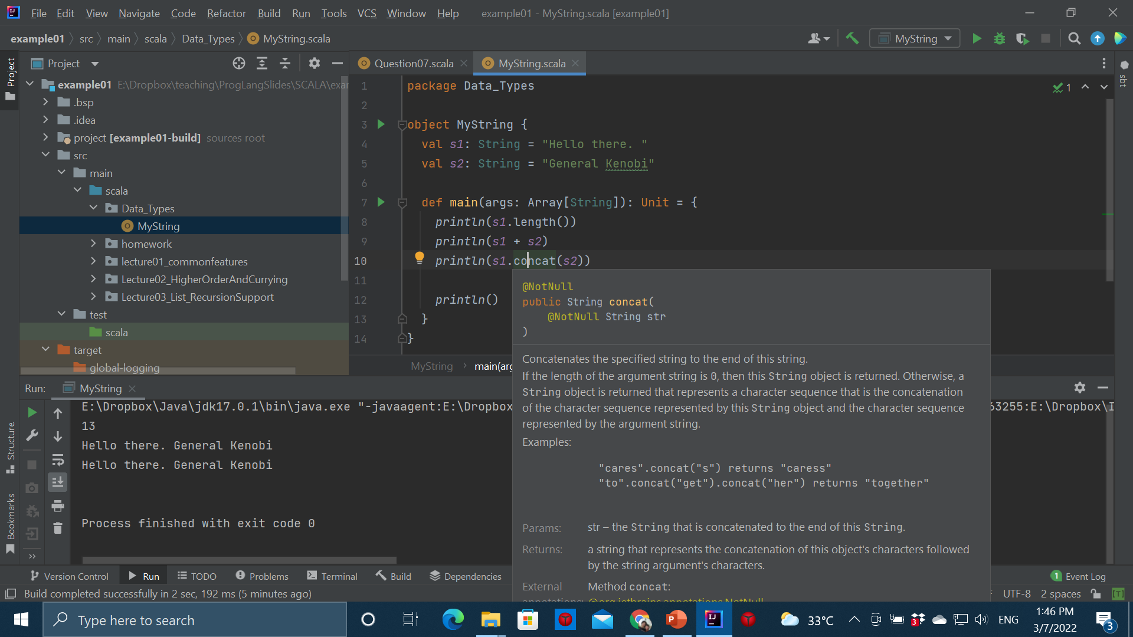


Slide 5
array
Store fixed size sequential data (must have the same type)
Default value for a slot depends on its data type.

Slide 6
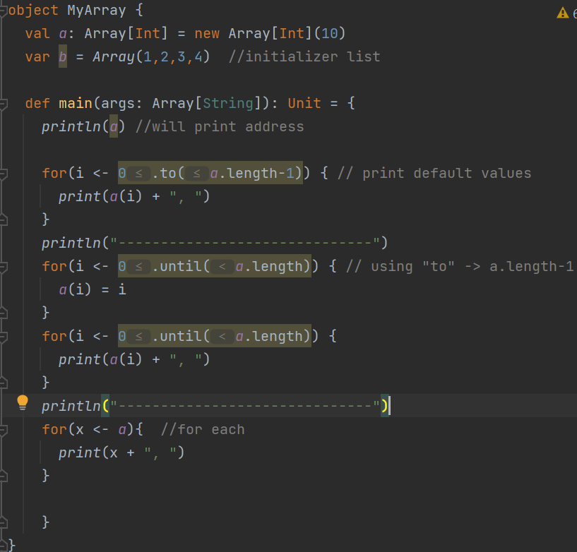
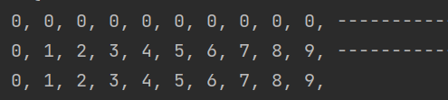
Notes:
object MyArray { val a: Array[Int] = new Array[Int](10) var b = Array(1,2,3,4) //initializer list def main(args: Array[String]): Unit = { println(a) //will print address for(i <- 0.to(a.length-1)) { // print default values print(a(i) + ", ") } println("------------------------------") for(i <- 0.until(a.length)) { // using "to" -> a.length-1 a(i) = i } for(i <- 0.until(a.length)) { print(a(i) + ", ") } println("------------------------------") for(x <- a){ //for each print(x + ", ") } } }

Slide 7
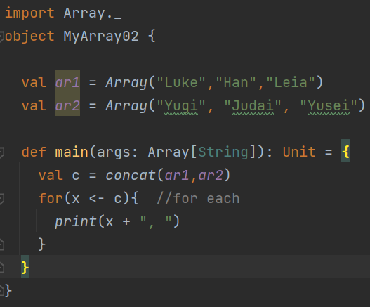

Array may need “import”
Notes:
import Array._ object MyArray02 { val ar1 = Array("Luke","Han","Leia") val ar2 = Array("Yugi", "Judai", "Yusei") def main(args: Array[String]): Unit = { val c = concat(ar1,ar2) for(x <- c){ //for each print(x + ", ") } } }

Slide 8
set
Collection of non-duplicated data.
They have to have the same data type.
By default, set is immutable.
Set is not ordered.
So its member does not have index.

Slide 9
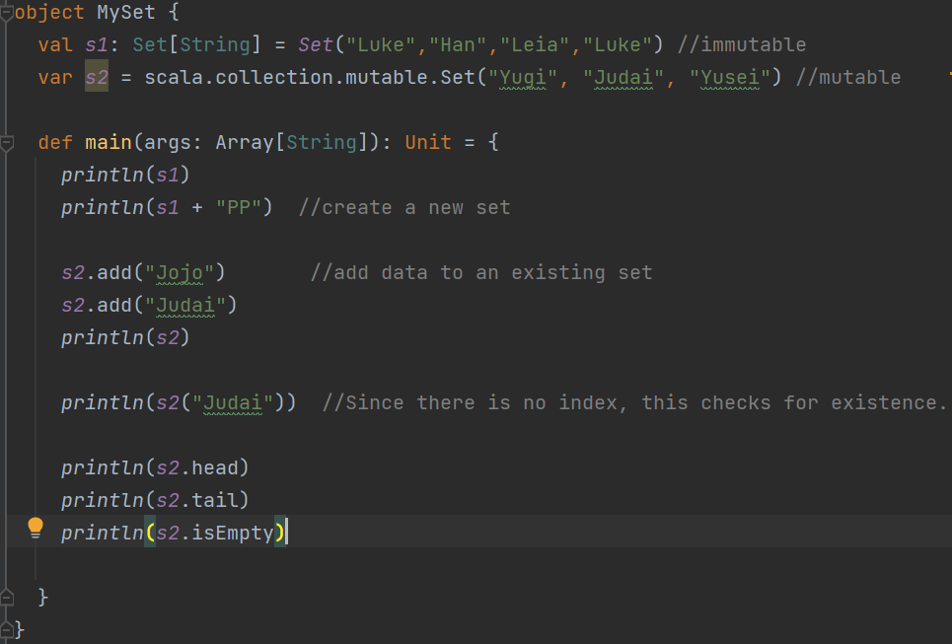
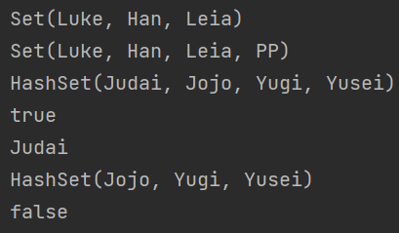



Notes:
object MySet { val s1: Set[String] = Set("Luke","Han","Leia","Luke") //immutable var s2 = scala.collection.mutable.Set("Yugi", "Judai", "Yusei") //mutable def main(args: Array[String]): Unit = { println(s1) println(s1 + "PP") //create a new set s2.add("Jojo") //add data to an existing set s2.add("Judai") println(s2) println(s2("Judai")) //Since there is no index, this checks for existence. println(s2.head) println(s2.tail) println(s2.isEmpty) } }

Slide 10
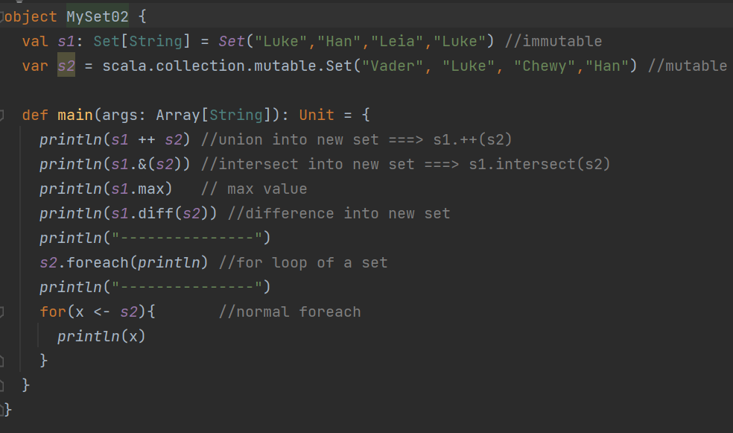
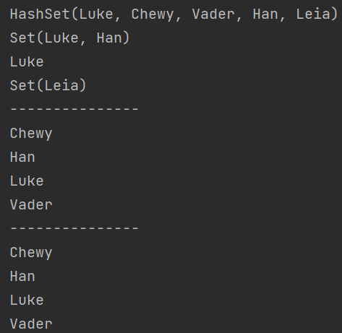


Notes:
bject MySet02 { val s1: Set[String] = Set("Luke","Han","Leia","Luke") //immutable var s2 = scala.collection.mutable.Set("Vader", "Luke", "Chewy","Han") //mutable def main(args: Array[String]): Unit = { println(s1 ++ s2) //union into new set ===> s1.++(s2) println(s1.&(s2)) //intersect into new set ===> s1.intersect(s2) println(s1.max) // max value println(s1.diff(s2)) //difference into new set println("---------------") s2.foreach(println) //for loop of a set println("---------------") for(x <- s2){ //normal foreach println(x) } } }

Slide 11
map
A collection of (key, value) pairs.
A key is unique.
you can choose between mutable/immutable map.

Slide 12
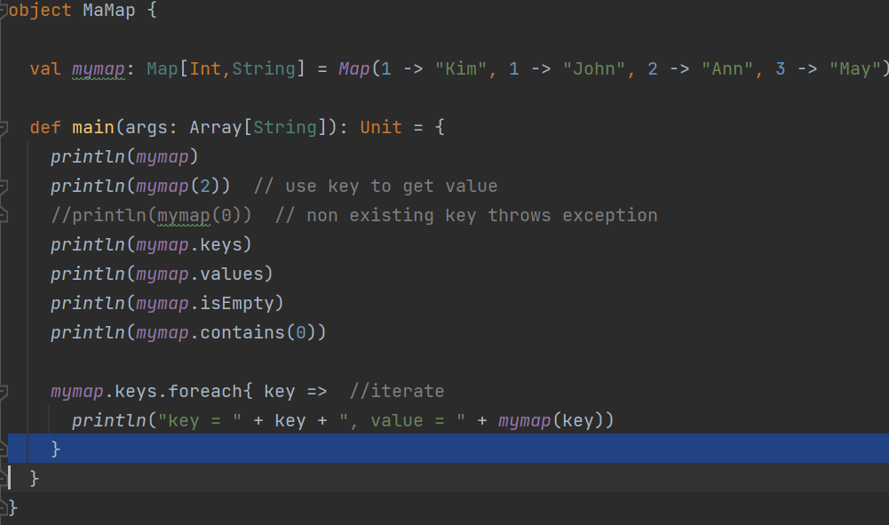
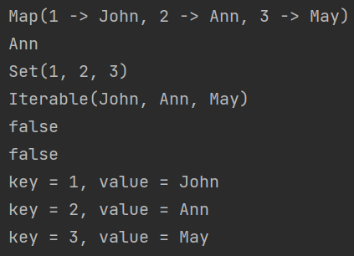


Notes:
object MaMap { val mymap: Map[Int,String] = Map(1 -> "Kim", 1 -> "John", 2 -> "Ann", 3 -> "May") def main(args: Array[String]): Unit = { println(mymap) println(mymap(2)) // use key to get value //println(mymap(0)) // non existing key throws exception println(mymap.keys) println(mymap.values) println(mymap.isEmpty) println(mymap.contains(0)) mymap.keys.foreach{ key => //iterate println("key = " + key + ", value = " + mymap(key)) } } }

Slide 13
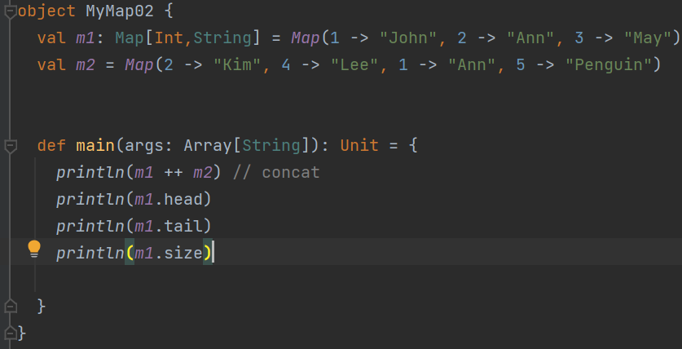
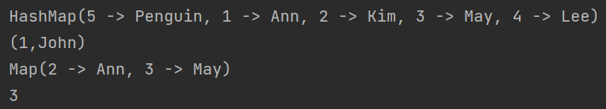
Notes:
object MyMap02 { val m1: Map[Int,String] = Map(1 -> "John", 2 -> "Ann", 3 -> "May") val m2 = Map(2 -> "Kim", 4 -> "Lee", 1 -> "Ann", 5 -> "Penguin") def main(args: Array[String]): Unit = { println(m1 ++ m2) // concat println(m1.head) println(m1.tail) println(m1.size) } }

Slide 14
tuple
Collection of values.
Can contain different data type.
Tuple is immutable!
Each touple can only contain upto 22 data.
Position in a tuple starts from 1.
Data in a map is actually a tuple.

Slide 15
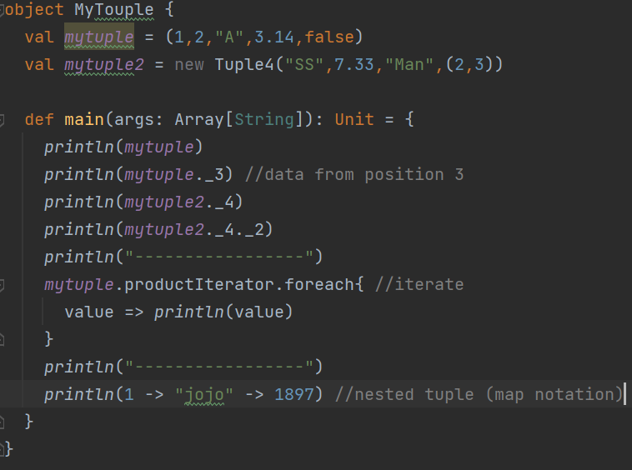
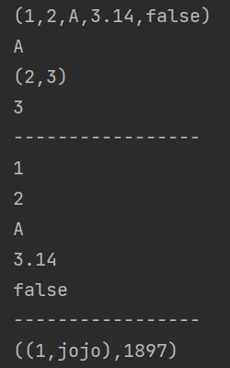


Notes:
object MyTouple { val mytuple = (1,2,"A",3.14,false) val mytuple2 = new Tuple4("SS",7.33,"Man",(2,3)) def main(args: Array[String]): Unit = { println(mytuple) println(mytuple._3) //data from position 3 println(mytuple2._4) println(mytuple2._4._2) println("-----------------") mytuple.productIterator.foreach{ //iterate value => println(value) } println("-----------------") println(1 -> "jojo" -> 1897) //nested tuple (map notation) } }

Slide 16
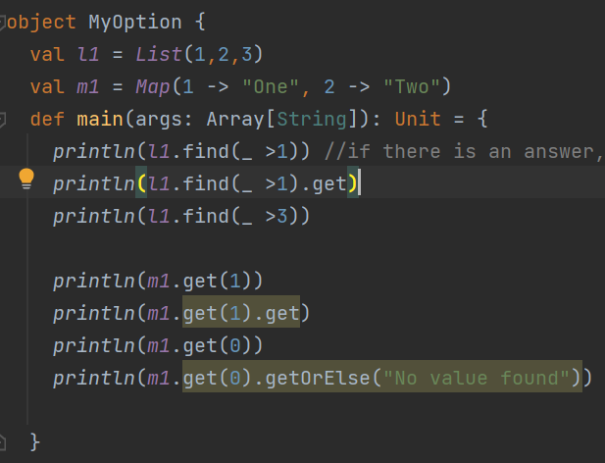
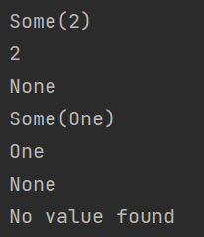


Option type
Normally used as a return type
For example: return an answer or None
Notes:
object MyOption { val l1 = List(1,2,3) val m1 = Map(1 -> "One", 2 -> "Two") def main(args: Array[String]): Unit = { println(l1.find(_ >1)) //if there is an answer, give the first answer, otherwise return None println(l1.find(_ >1).get) println(l1.find(_ >3)) println(m1.get(1)) println(m1.get(1).get) println(m1.get(0)) println(m1.get(0).getOrElse("No value found")) } }

Slide 17
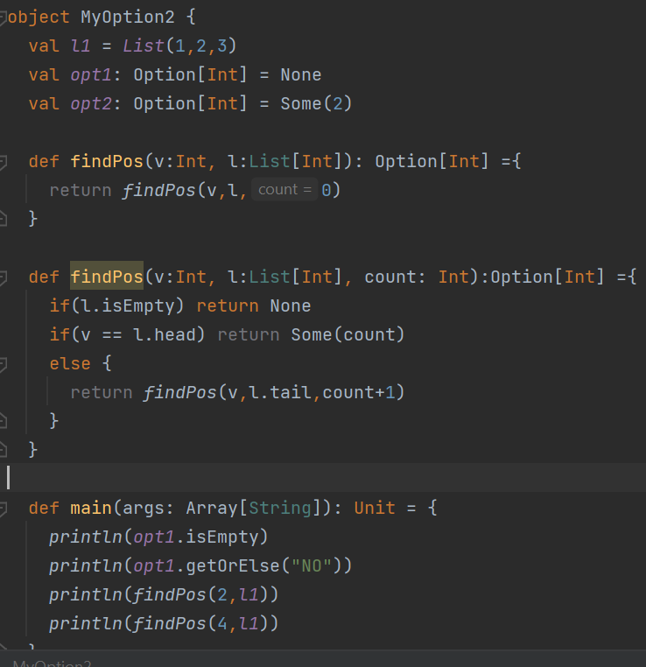
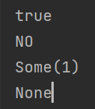
Notes:
object MyOption2 { val l1 = List(1,2,3) val opt1: Option[Int] = None val opt2: Option[Int] = Some(2) def findPos(v:Int, l:List[Int]): Option[Int] ={ return findPos(v,l,0) } def findPos(v:Int, l:List[Int], count: Int):Option[Int] ={ if(l.isEmpty) return None if(v == l.head) return Some(count) else { return findPos(v,l.tail,count+1) } } def main(args: Array[String]): Unit = { println(opt1.isEmpty) println(opt1.getOrElse("NO")) println(findPos(2,l1)) println(findPos(4,l1)) } }

